Slide 1
Foundations of Cryptography multi-party computation, secret sharing
LiangFeng Zhang
zhanglf@shanghaitech.edu.cn

Slide 2





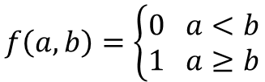
Advanced Topics
Beyond the Confidentiality and Integrity in the two-party model:
Confidentiality + Integrity is enough? No.
What happens if more than two parties are communicating with each other?
What happens if some of the parties are malicious?
Multi-Party Computation: Millionaires’ Problem
Who is wealthier?
$$f\left(a,b\right)=\left\{\begin{aligned}0 a<b \\ 1 a≥b\end{aligned}\right.$$
Millionaire Alice
$$f\left(a,b\right)=?$$
Millionaire Bob
$a$ million dollars
$b$ million dollars

Slide 3


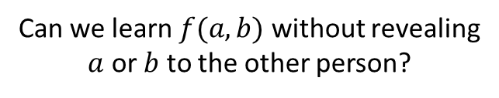
Advanced Topics
Beyond the Confidentiality and Integrity in the two-party model:
Confidentiality + Integrity is enough? No.
What happens if more than two parties are communicating with each other?
What happens if some of the parties are malicious?
Multi-Party Computation: Millionaires’ Problem
I have $a$ million dollars
$$f\left(a,b\right)=1$$
Millionaire Alice
Bob learns too much about me?!
Millionaire Bob
$a$ million dollars
Can we learn $f(a,b)$ without revealing
$a$ or$b$to the other person?
$b$ million dollars
I am wealthier!
Work harder!

Slide 4


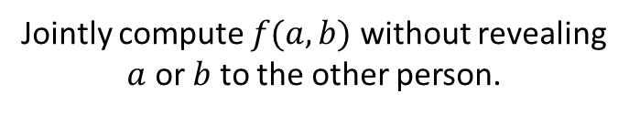
Advanced Topics
Beyond the Confidentiality and Integrity in the two-party model:
Confidentiality + Integrity is enough? No.
What happens if more than two parties are communicating with each other?
What happens if some of the parties are malicious?
Multi-Party Computation: Millionaires’ Problem
Jointly compute $f(a,b)$ without revealing
$a$ or$b$to the other person.
Alice
A.C.C. Yao 1982
Bob
$$a$$
Turing Award 2000
$$b$$

Slide 5




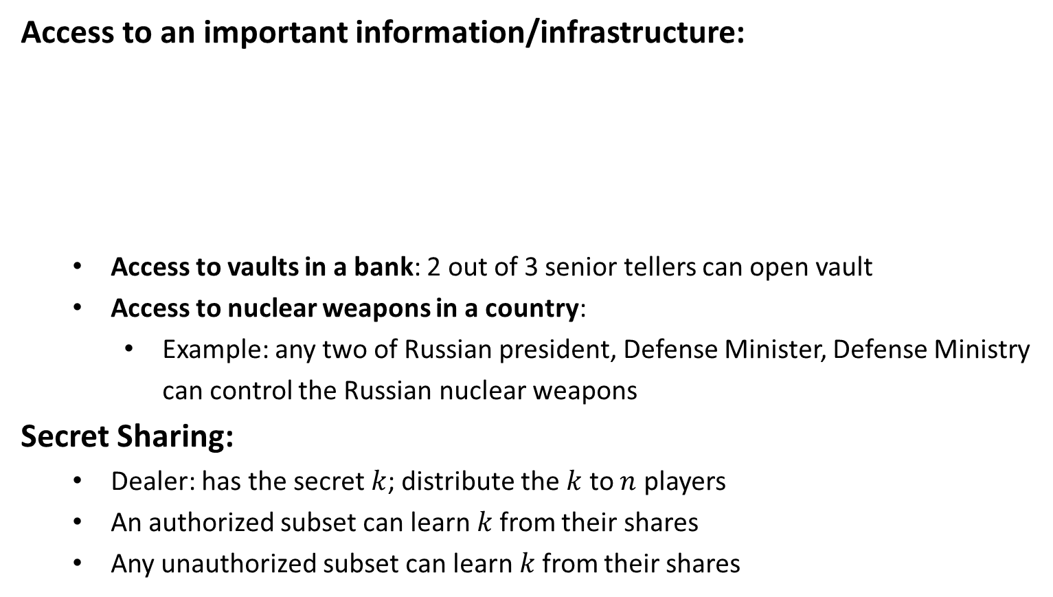






Advanced Topics
Access to an important information/infrastructure:
Access to vaults in a bank: 2 out of 3 senior tellers can open vault
Access to nuclear weapons in a country:
Example: any two of Russian president, Defense Minister, Defense Ministry can control the Russian nuclear weapons
Secret Sharing:
Dealer: has the secret $k$; distribute the $k$ to $n$ players
An authorized subset can learn$k$from their shares
Any unauthorized subset can learn$k$from their shares
$$k$$
$$k_{1}$$
$$k$$
$$k_{2}$$
$$k$$
$$k$$
$$k$$
$$k_{3}$$

Slide 6
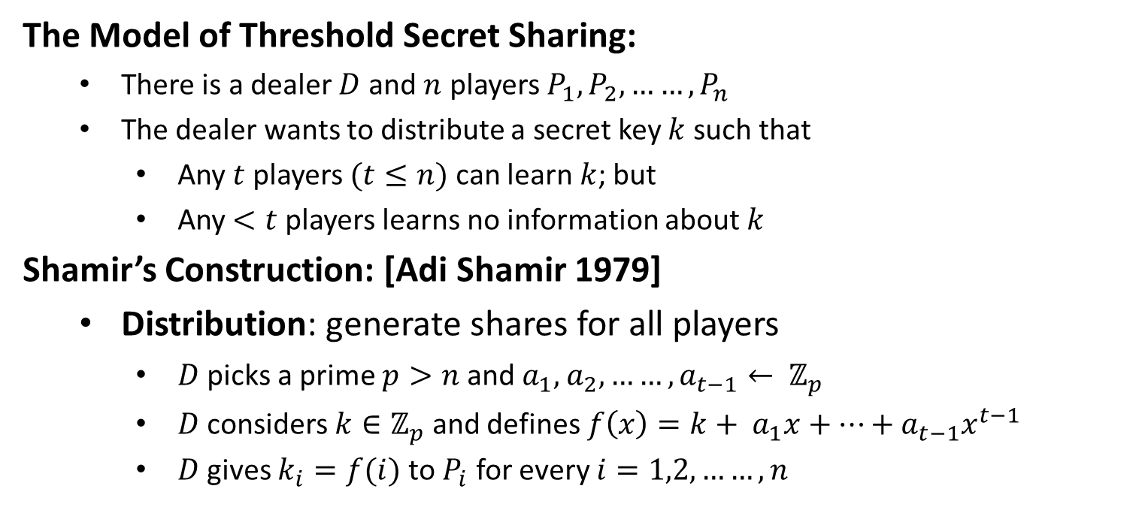
Threshold Secret Sharing
The Model of Threshold Secret Sharing:
There is a dealer $D$ and $n$ players $P_{1},P_{2}, ……,P_{n}$
The dealer wants to distribute a secret key $k$ such that
Any $t$ players $(t≤n)$ can learn $k$; but
Any $<t$ players learns no information about $k$
Shamir’s Construction: [Adi Shamir 1979]
Distribution: generate shares for all players
$D$ picks a prime $p>n$ and${ a}_{1},$ $a_{2}, ……, a_{t−1}← ℤ_{p}$
$D$ considers $k∈ℤ_{p}$ and defines $f\left(x\right)=k+{ a}_{1}x+…+a_{t−1}x^{t−1}$
$D$ gives $k_{i}=f(i)$ to $P_{i}$ for every $i=1,2, ……, n$

Slide 7

Threshold Secret Sharing
Reconstruction: $P_{1}, P_{2}, ……, P_{t}$ wants to learn $k$
$k_{i}=f(i)$ for every $i=1,2, ……, t$
$f\left(x\right)=k+{ a}_{1}x+…+a_{t−1}x^{t−1}$
Security: any $t−1$ players learns no information on $k$

Slide 8
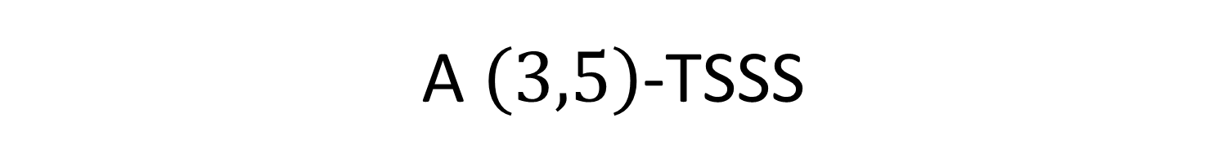
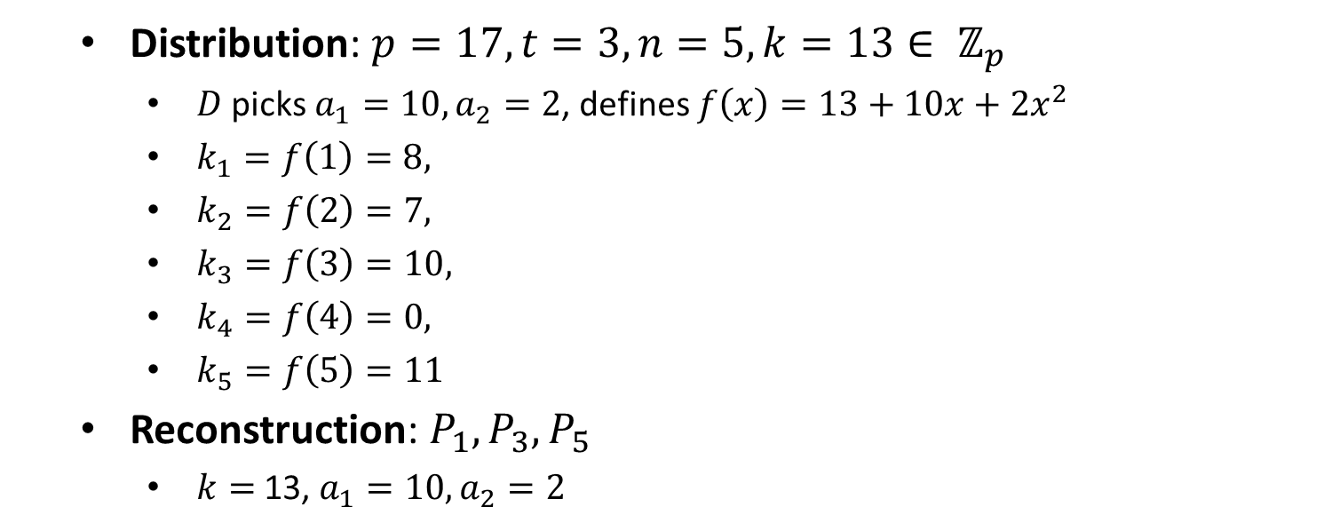
A $\left(3,5\right)$-TSSS
Distribution: $p=17, t=3, n=5, k=13∈ ℤ_{p}$
$D$ picks $a_{1}=10, a_{2}=2$, defines $f\left(x\right)=13+10x+2x^{2}$
$k_{1}=f\left(1\right)=8,$
$k_{2}=f\left(2\right)=7,$
$k_{3}=f\left(3\right)=10,$
$k_{4}=f\left(4\right)=0,$
$k_{5}=f\left(5\right)=11$
Reconstruction: $P_{1}, P_{3}, P_{5}$
$k=$ 13, $a_{1}=10, a_{2}=2$

Slide 9
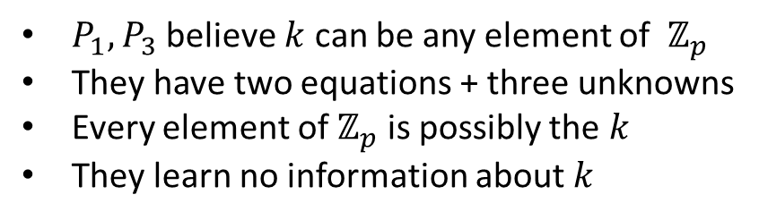
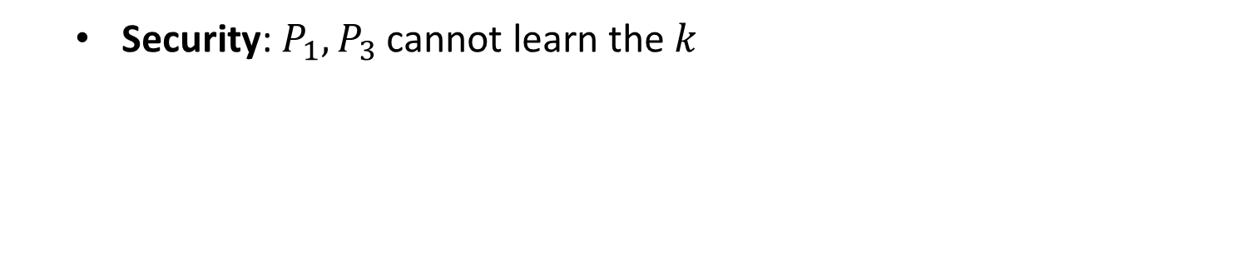
A $\left(3,5\right)$-TSSS
Security: $P_{1}, P_{3}$ cannot learn the $k$
$P_{1}, P_{3}$ believe $k$ can be any element of $ℤ_{p}$
They have two equations + three unknowns
Every element of $ℤ_{p}$ is possibly the $k$
They learn no information about $k$

